Slide 1
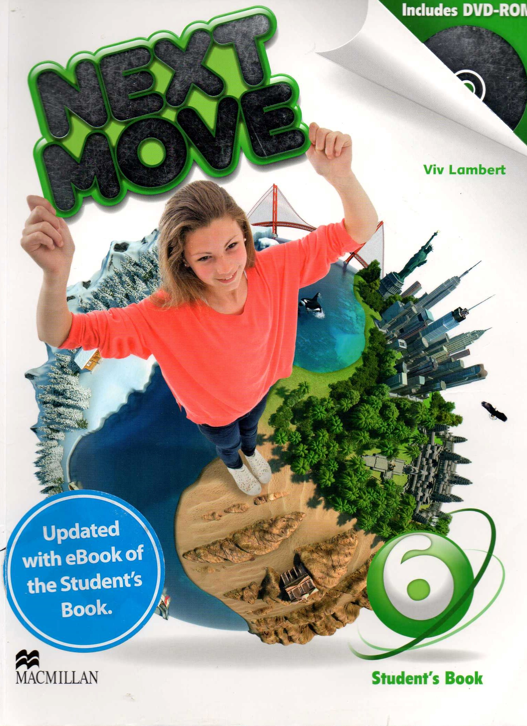
Holland

Slide 2
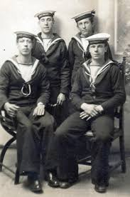
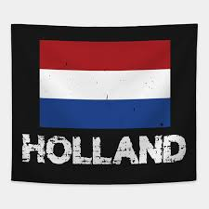
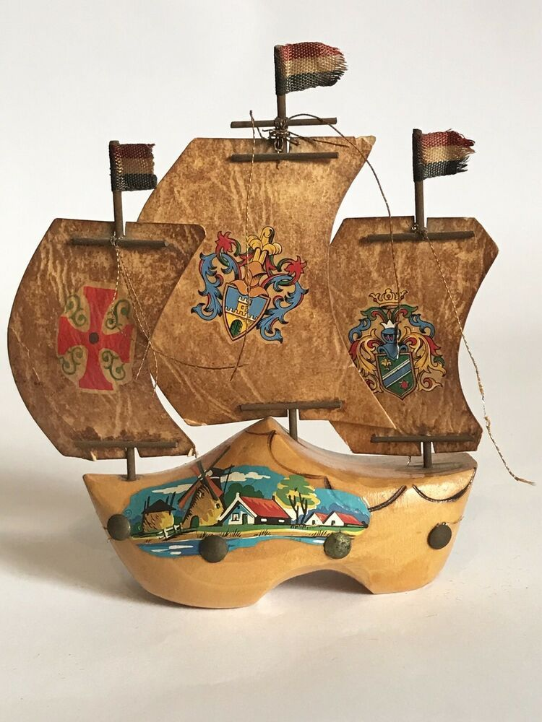
Holland is a small country with a very interesting history. In the past, there weren’t any planes, trains, or cars, but Holland had large numbers of ships, and many people were sailors or explorers.

Slide 3
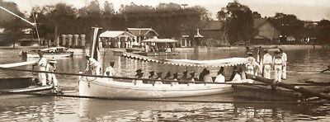
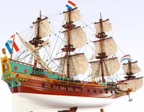
The ships were small and they weren’t very comfortable or fast, but Dutch sailors were excellent explorers.

Slide 4
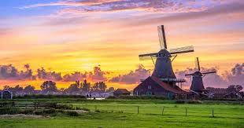
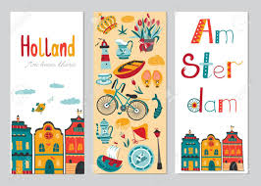
In the 17th century, Holland was a very rich country. The Dutch people collected things from all over the world, including from the Americas, Malaysia, and Indonesia.

Slide 5
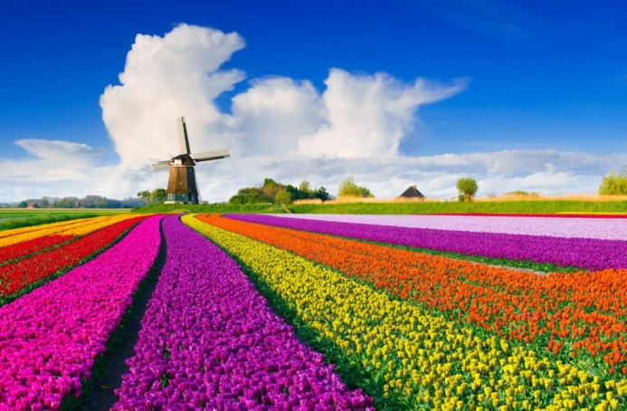
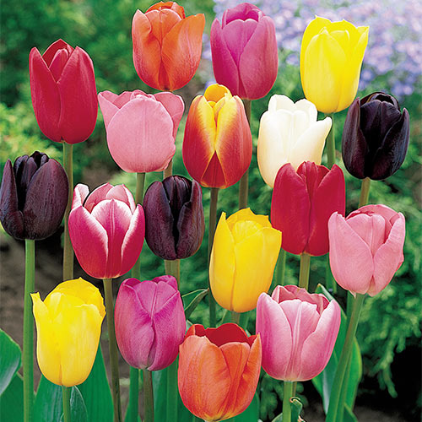
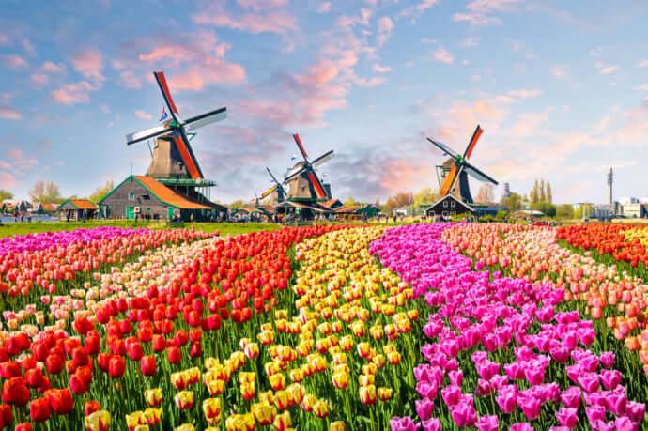
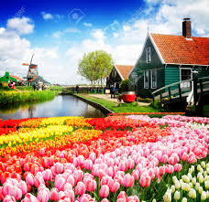
Some of the most popular things to collect were tulip flowers. Tulips were very expensive; in fact, they were the most expensive flowers in the world! One Tulip flower was more expensive than a house.

